Slide 1

CEIR Custom Stakeholder -Training Manual

Slide 2

Agenda
Importer Definition and Overview
Assumptions
Features
Registration
Dashboard
Consignment
Stock Management
Grievance
Individual Tax Payment Cases
Profile Management

Slide 3
Custom - Definition
Cambodian Customs (Government) who is responsible for validating the imported consignment as per the designed procedure by Government.
Customs also collects the Import Duty from Importer or Third party organization or Individuals or tourists based on the custom value and law and to clear their consignment for further distribution or usage in Cambodia for commercial or personnel usage.
Only authority in Cambodia to collect the custom duty is Cambodian custom department. CEIR authority does not collect import duty/taxes.

Slide 4
Assumptions
1 | Importers will be able to take the device related information from their suppliers and upload the same into the CEIR system
2 | There will be regulation in place for Customs officials to register with CEIR authority in the respective phases of project rollout
3 | Importers , Distributers , Retailers, Individual anyone can place the Consignment to Import and pay the duty to Customs
4 | Any tax relief/Concession provided to Importers/Distributers/Retailers to log their relief status with respective government tax or Custom department. CEIR will not keep any information related to Tax relief to mentioned entities
5 | Regulation has to be in place for rejecting the device upload based on the Invalid TAC.
6 | All the tax related regulation to be governed by Customs only in the current CEIR system. Other tax related departments are not involved in current platform.
7 | Regulation to be in place for allowing Customs to regulate the devices in time bound manner for end-to-end clearance of devices

Slide 5
Registration – Custom
Custom select the port. The port could be
Air
Water
Land
Custom select the port address from the defined list in CEIR system

Slide 6
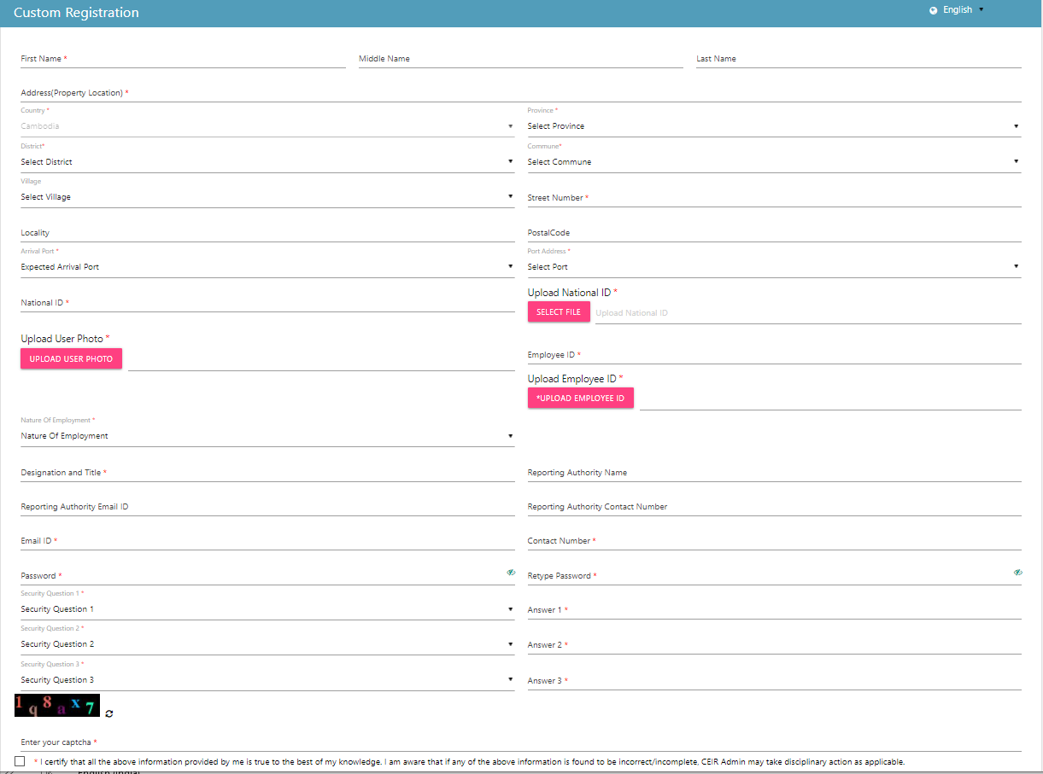
Registration – Custom (Form)

Slide 7
Dashboard – Custom
The Dashboard has information about the following
Total number of consignments in progress
Total Devices in transit
Stock requests uploaded by the Customs
Total devices waiting for upload
Total Grievances raised by the Customs
Notifications on feature requests raised by the Customs

Slide 8
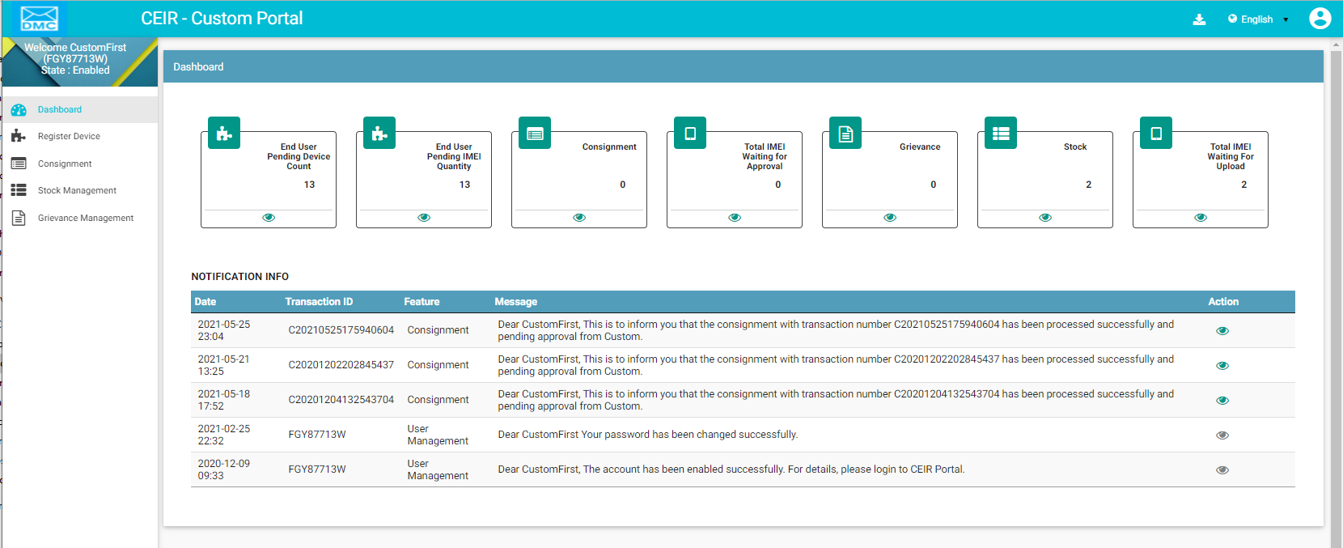
Dashboard – Customs
Language Change
Left Panel
Work Area
All features status
Download User Manual
Edit Profile
Notifications
On click it takes user to respective home page

Slide 9
Consignment – Customs
Once the Importers purchase consignments from suppliers, Importer need to pay tax.
Once the CEIR Admin has approved the consignment, it is sent to Custom queue for approval
Custom can either approve or reject the consignment
If consignment is found to be ok as per customs, and taxes are paid by Importers, then
Custom should approve the consignment.
In case custom has any objection with respect to information provided in the consignment, the same can be rejected as well.
All custom official sees the same view. So, if 5 consignment are waiting to be approved, then all registered custom officials will see the 5 consignments

Slide 10
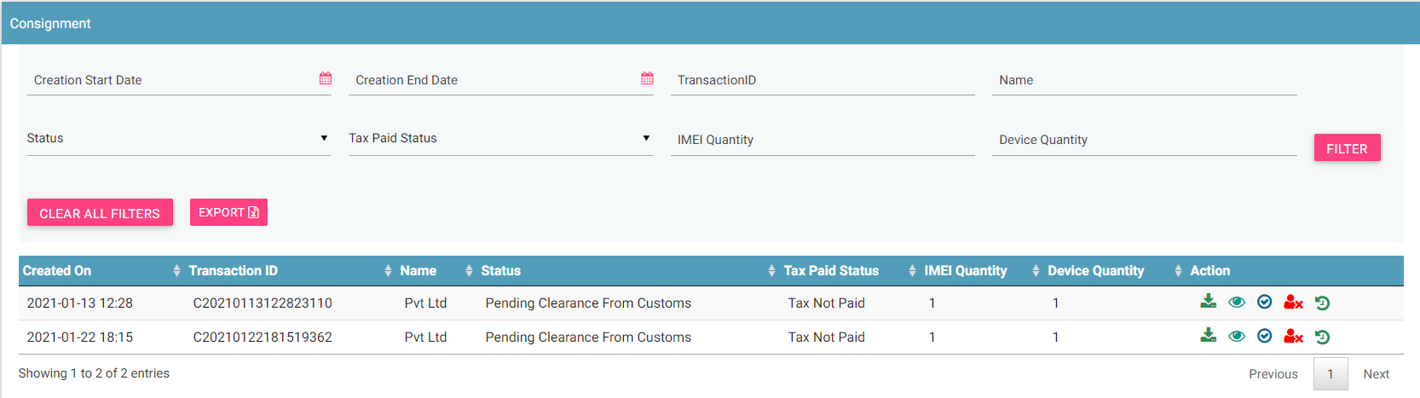
Consignment – Customs
Filters
Export
View All Consignment
Action like Download, View, Approve, Reject, History
© 2019-2020 Sterlite Technologies Limited
10

Slide 11
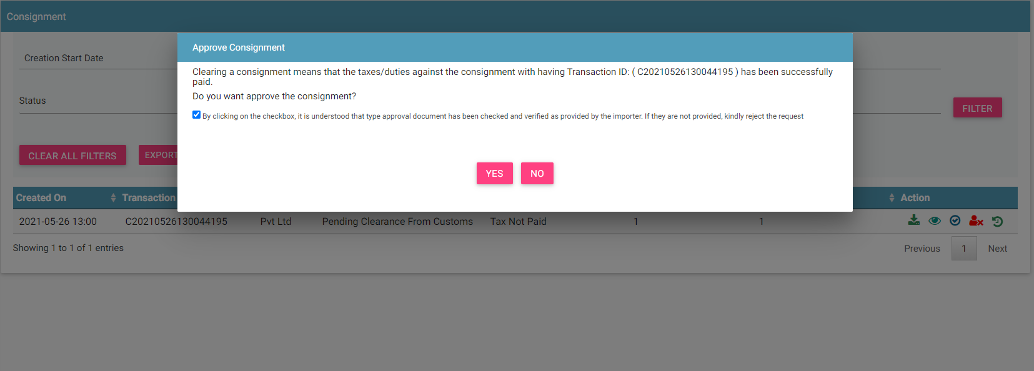
Consignment – Customs - Approve
© 2019-2020 Sterlite Technologies Limited
11

Slide 12
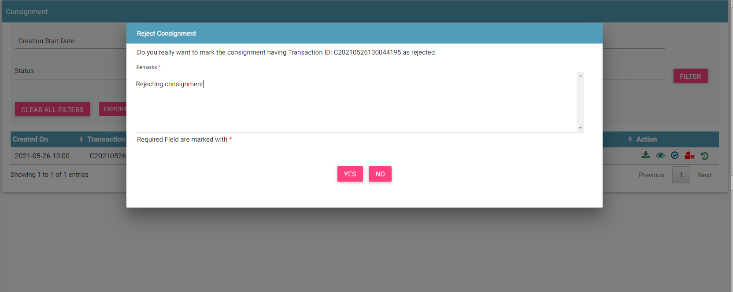
Consignment – Customs - Reject
© 2019-2020 Sterlite Technologies Limited
12

Slide 13
Stock Management – Customs

Slide 14
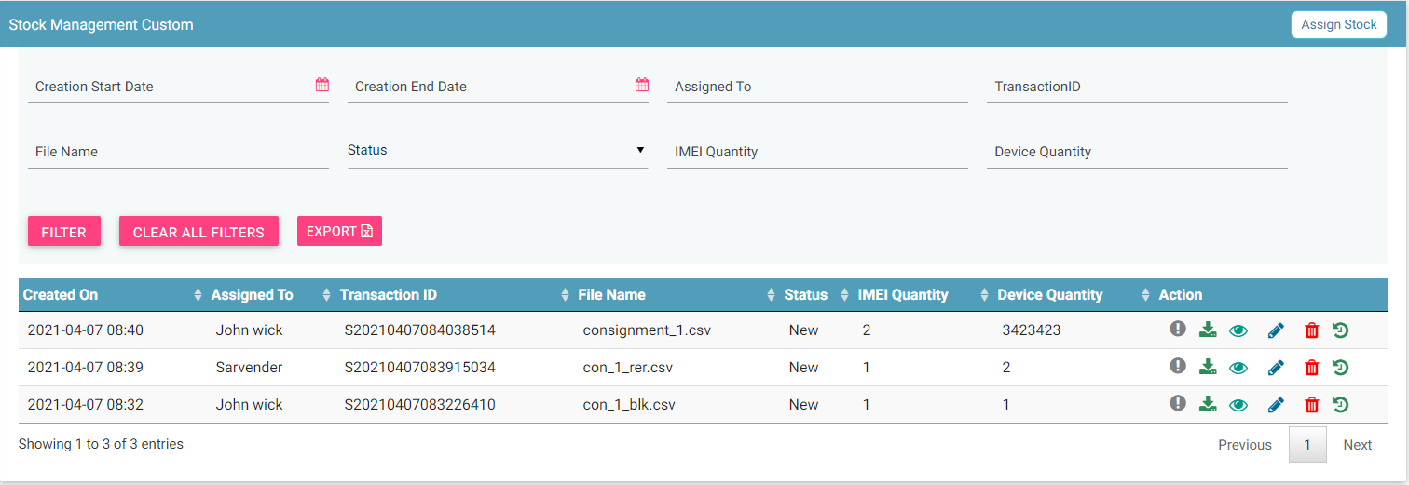
Stock Management – Custom
Assign Stock
Filters
View All Stocks
Export
Action like View, Delete

Slide 15
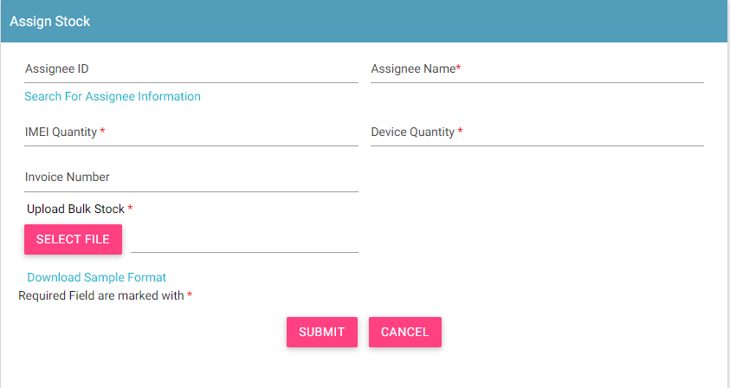
Stock Management – Assign Stock
Steps to Assign Stock
Search for the assignee Information and select the assignee.
Mandatory fields are Assignee ID, Assignee Name, Quantity and Bulk file.

Slide 16
Individual Tax Paid – Custom

Slide 17
Grievance – Custom

Slide 18
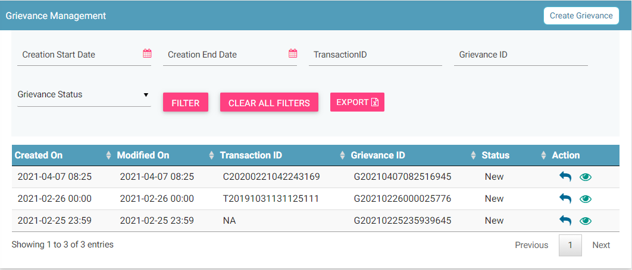
Grievance – Custom
Report
Filters
Export
Action like View, Reply
View All grievances

Slide 19
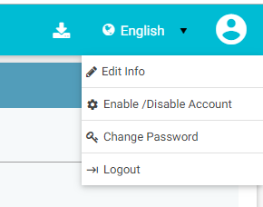
Profile Management

Slide 20
Queries

Slide 21
Thank You

